Slide 1
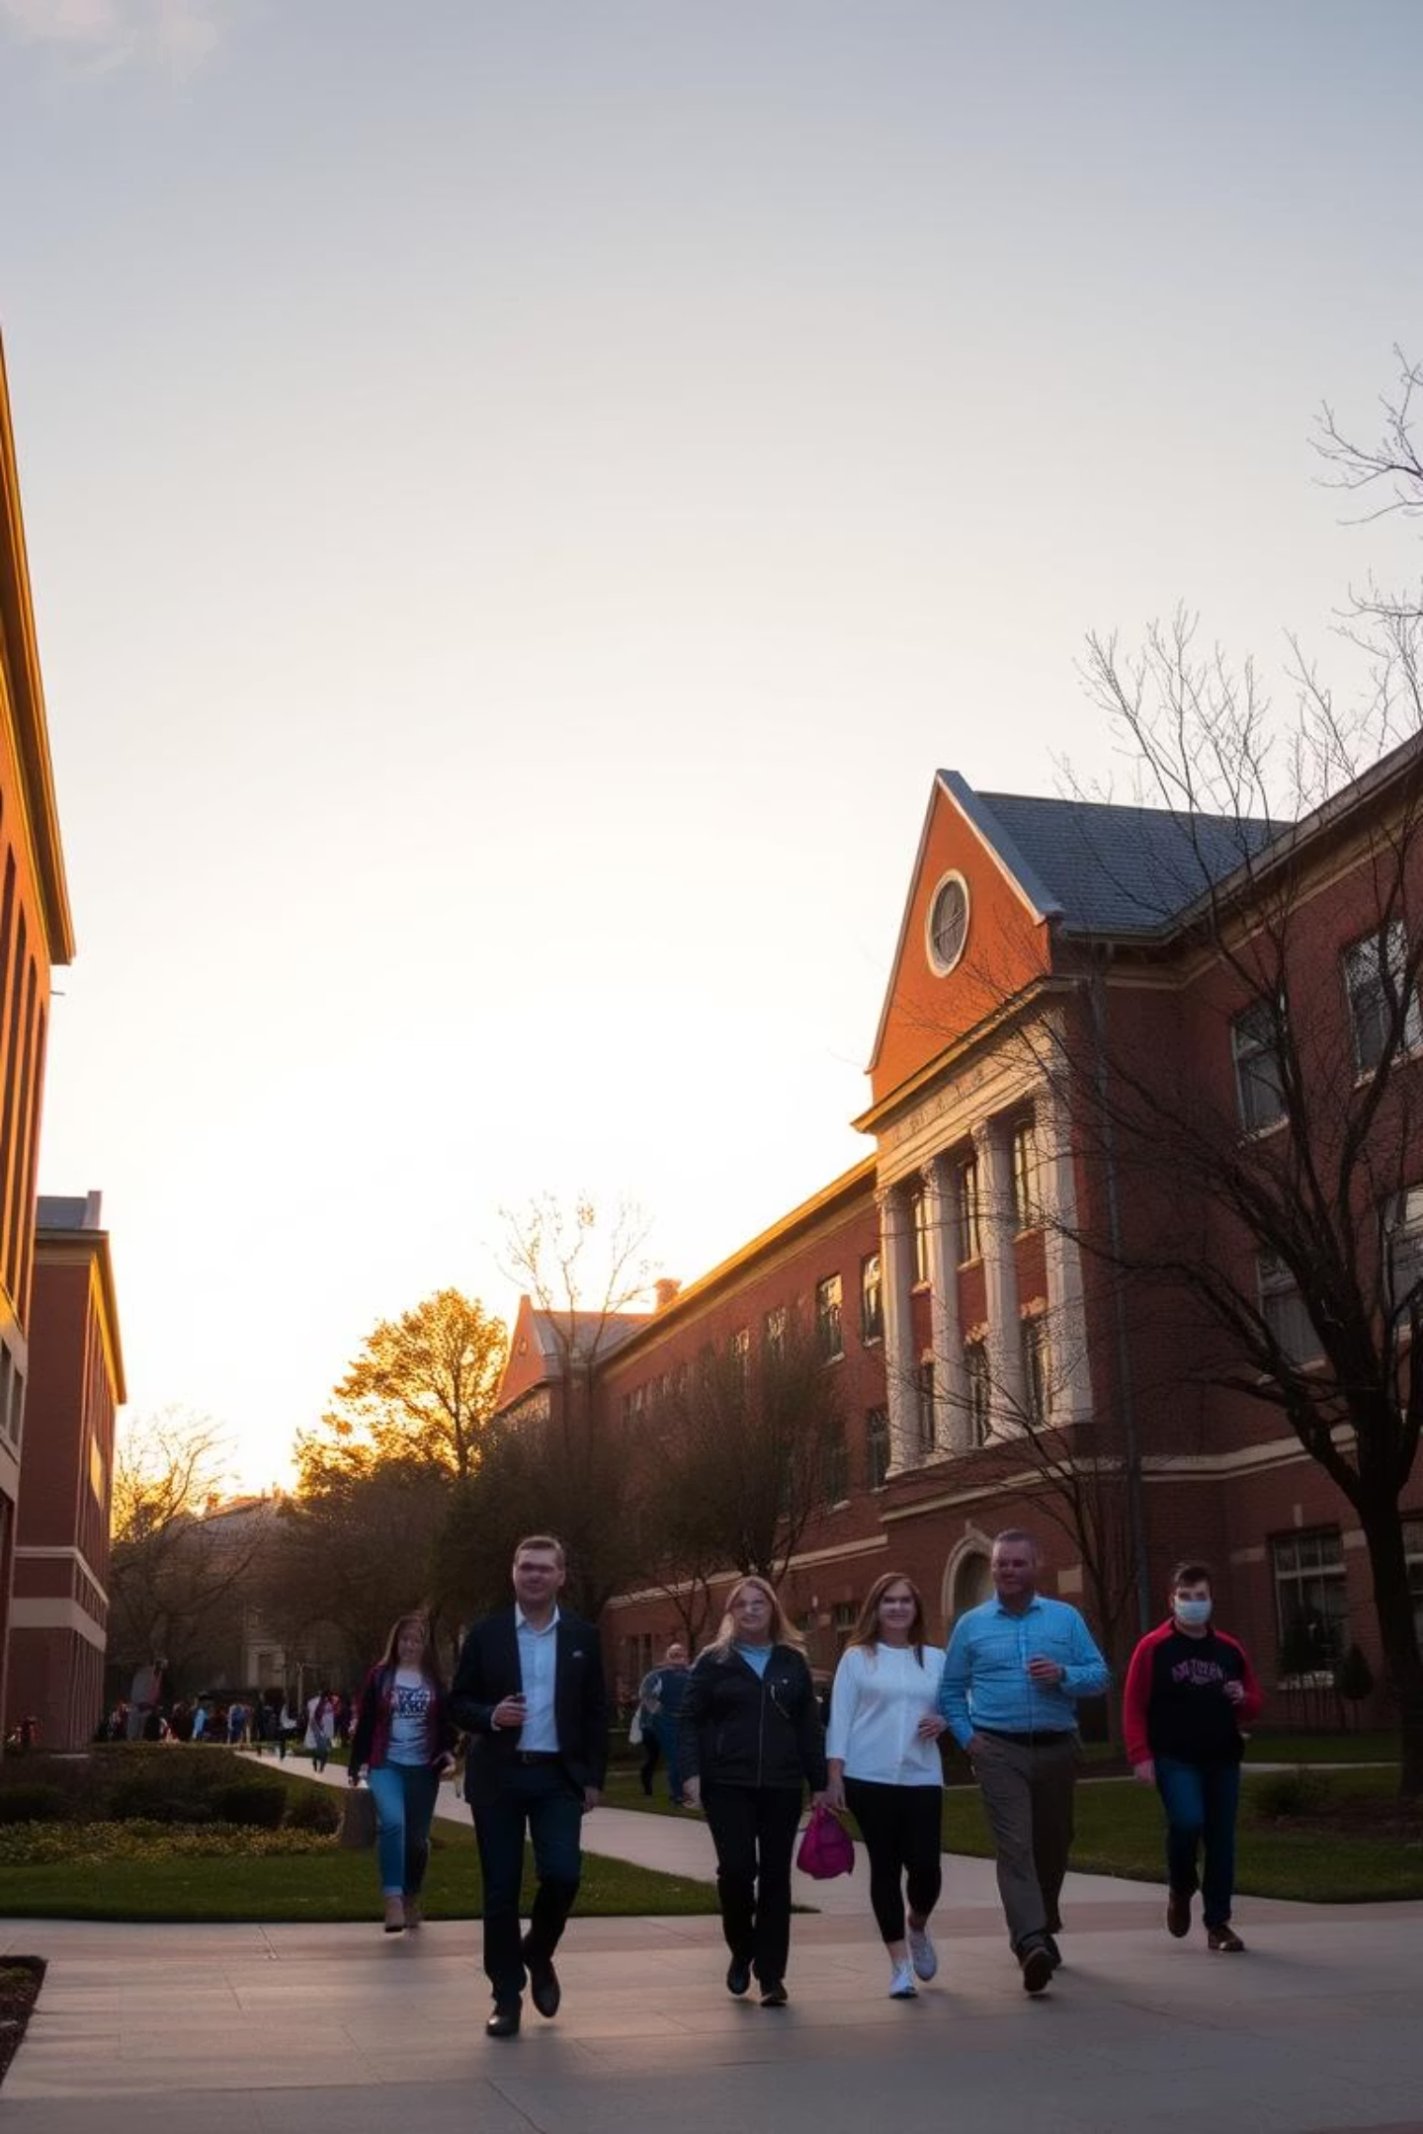

Empowering educational institutions through advanced performance tracking. Our solution enhances student outcomes and operational efficiency. We are at the forefront of educational innovation.

Slide 2

The Challenge: Understanding Student Journeys
Why Now?
For Whom?
The Problem
Traditional methods fail to capture dynamic student progress. Universities need better insights to support their students effectively.
This system benefits students, faculty, and administrators alike. It helps everyone make data-driven decisions for academic improvement.
Current systems lack comprehensive tracking of performance and attendance trends. Identifying at-risk students is a major challenge.

Slide 3
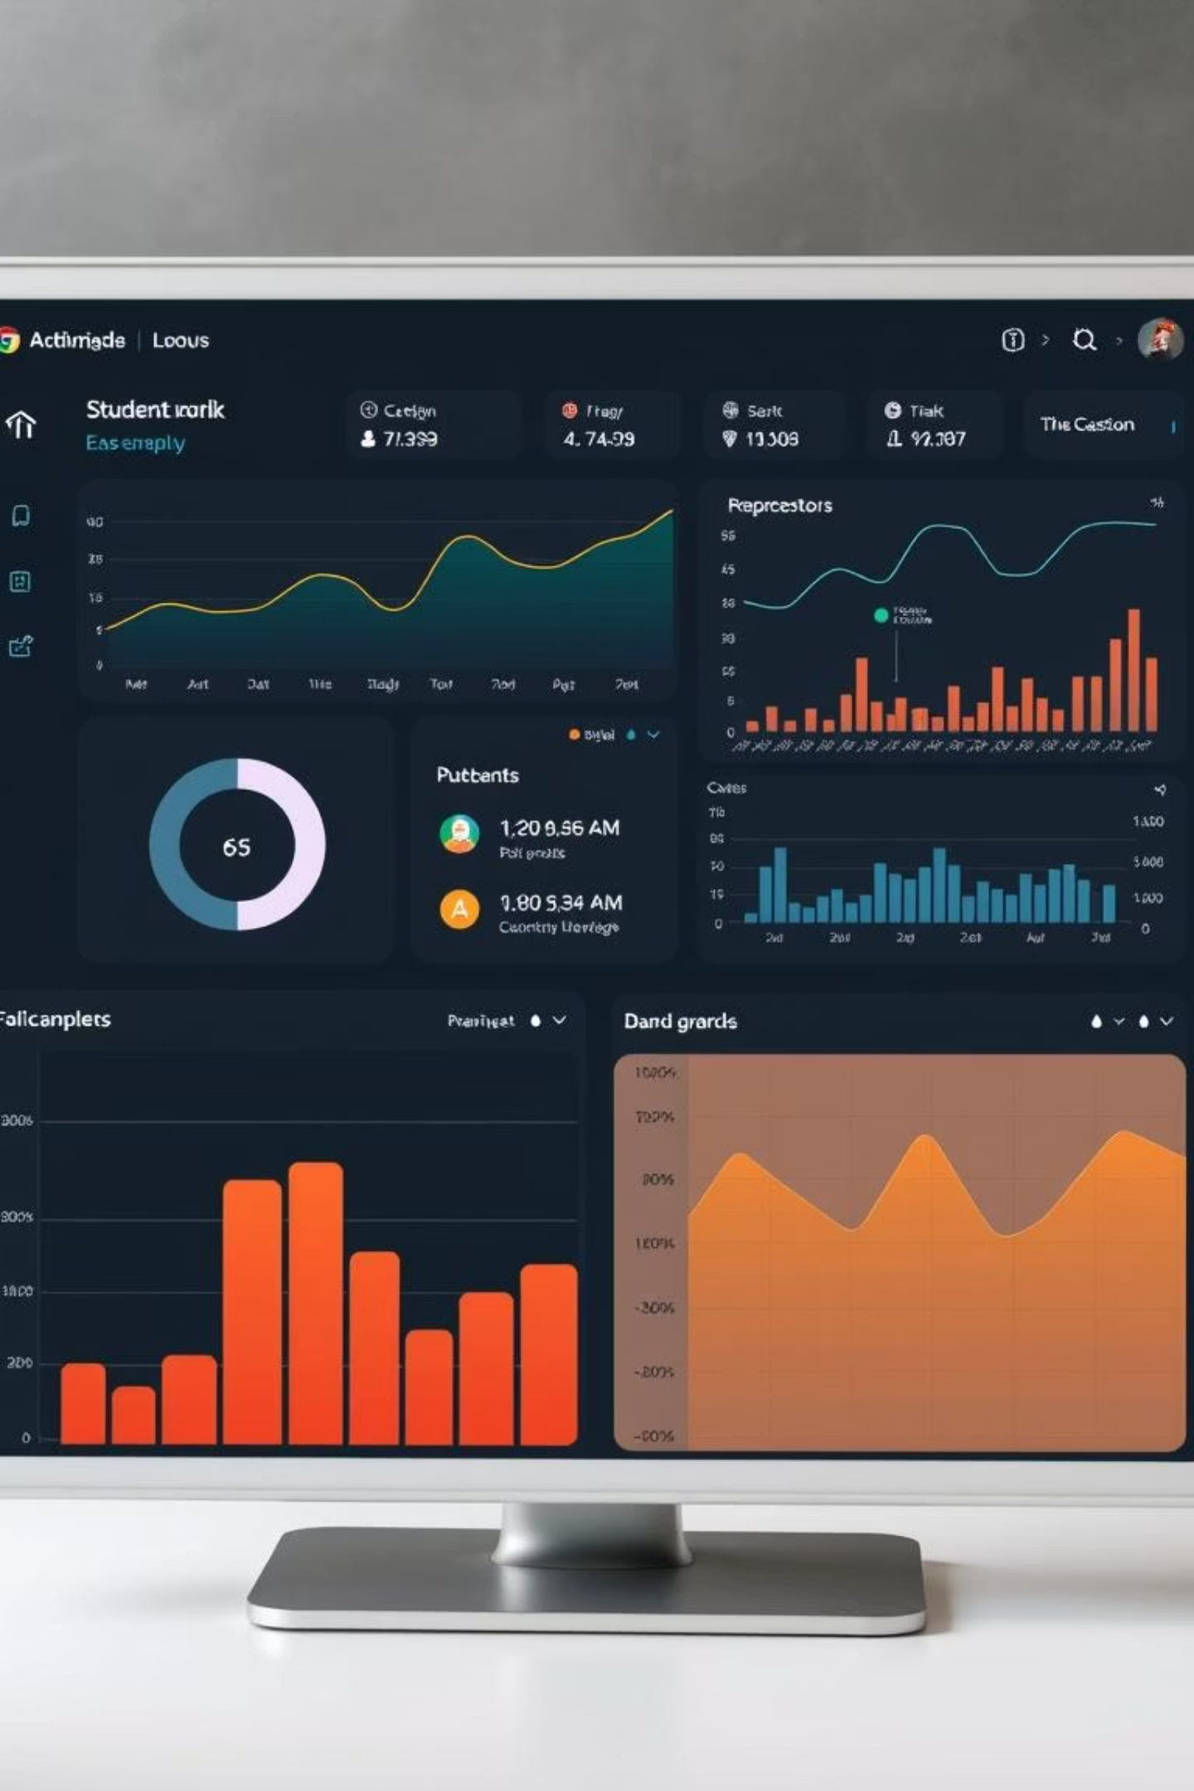
Our Solution: A Holistic Performance Tracker
Our system integrates key data points for a complete view. It leverages automation for efficient data analysis and timely interventions.
Automated Insights
Comprehensive Data
Automated alerts for declining performance. Early intervention becomes seamless.
Integrates grades, attendance, and engagement metrics. Provides a 360-degree student view.
User-Friendly
Intuitive interface for easy navigation and data access. Designed for all stakeholders.

Slide 4
Product Overview: Key Features
Automated Data Import
Subject-Wise Dashboards
Seamless integration with existing university systems. Reduces manual data entry errors.
Visual summaries of performance by subject. Helps faculty pinpoint areas for improvement.
Low-Performing Student Identification
Attendance Tracking
Algorithmic analysis flags students needing support. Provides proactive intervention opportunities.
Monitors attendance trends for each student. Contributes to a holistic performance view.

Slide 5

Business Analysis: Ensuring Success
Our approach emphasizes thorough analysis and stakeholder engagement. This ensures the system meets all university requirements.
1
Workshops with Academic Departments
2
Define UAT Checklist
Comprehensive criteria for user acceptance testing. Guarantees system quality and usability.
Gather detailed requirements and feedback. Ensures system alignment with educational needs.

Slide 6
Technical Foundations: Data and Diagrams
Excel Tasks
UML Diagrams
Pivot table for subject-wise grading.
Sequence Diagram for Course Enrollment.
Conditional formatting for performance tiers.
Deployment Diagram for LMS.
These technical documents ensure robust system architecture. They also provide clarity for development and deployment.

Slide 7


Moving Forward: Next Steps
We are ready to transform student performance tracking. Our project will deliver significant value to the university.

Slide 8
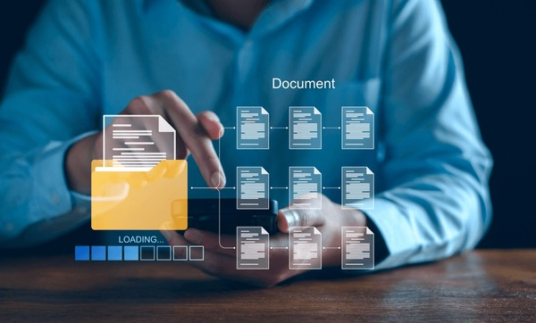
Documentation

Slide 9
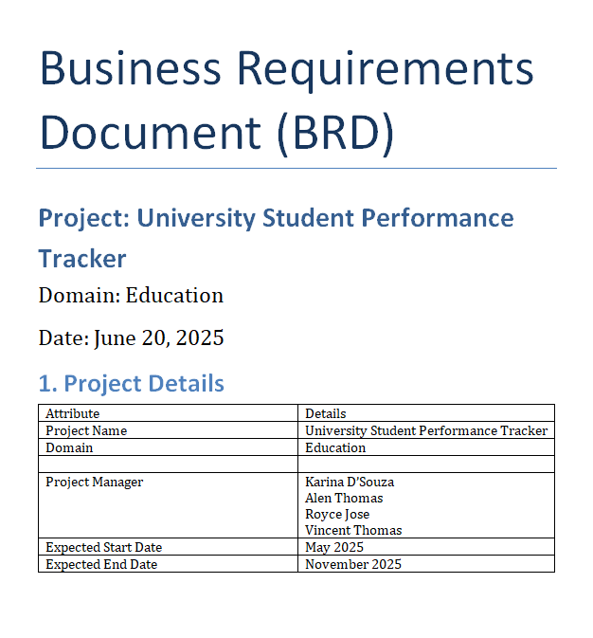
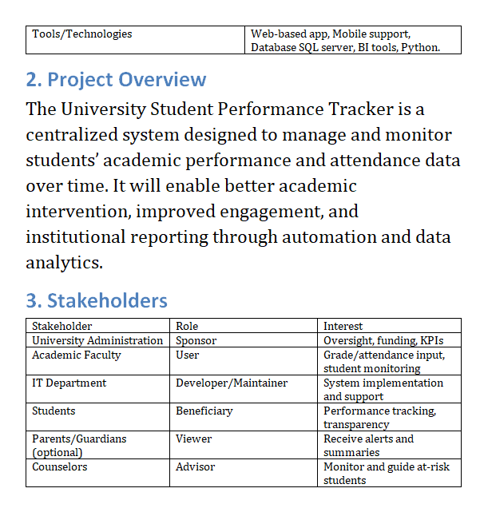
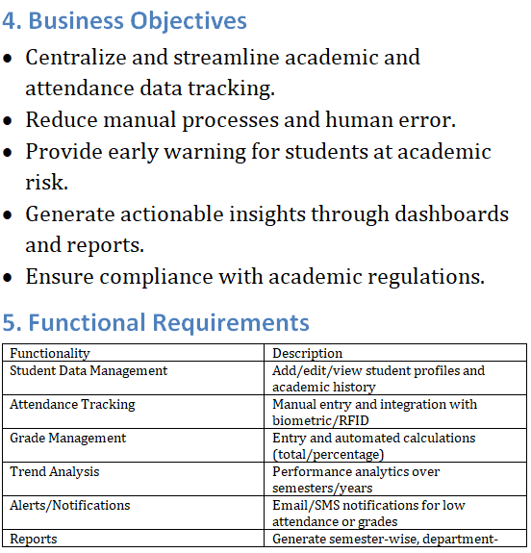

Slide 10
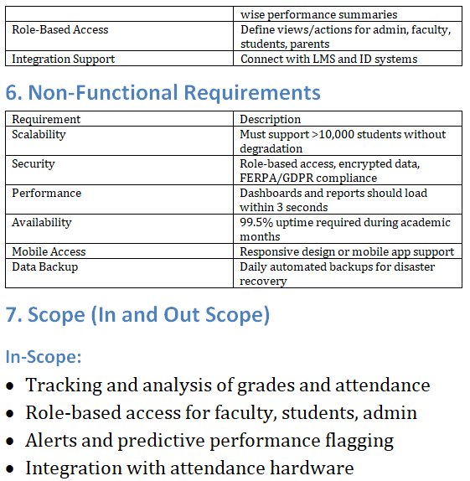
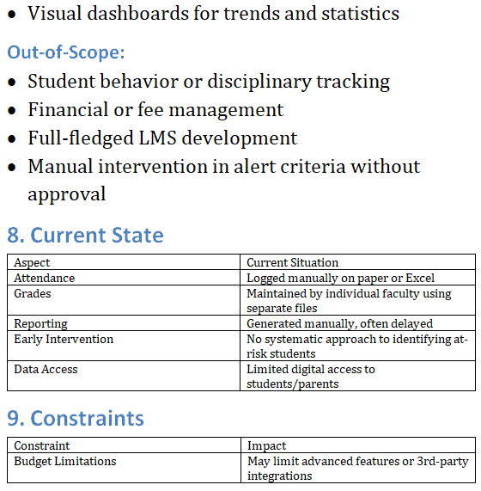
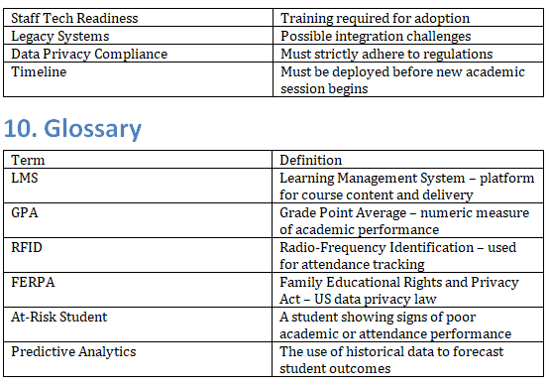

Slide 11
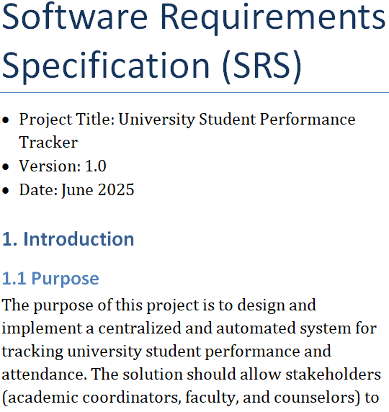
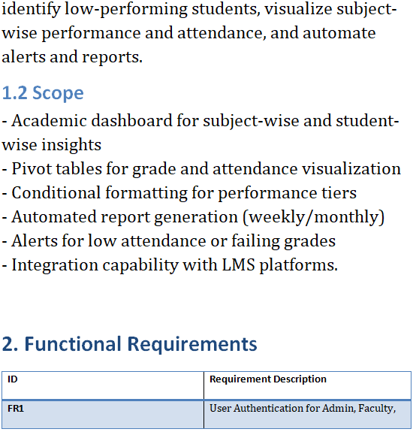
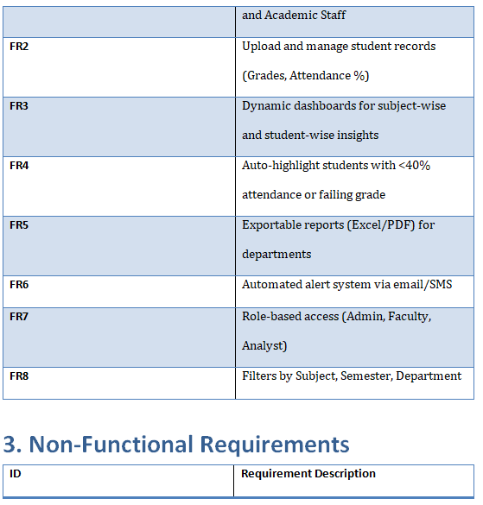

Slide 12
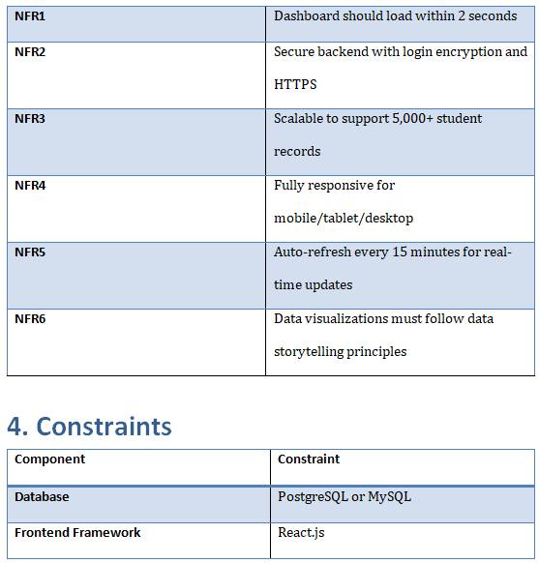
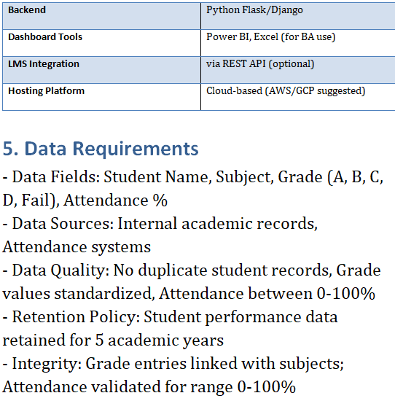
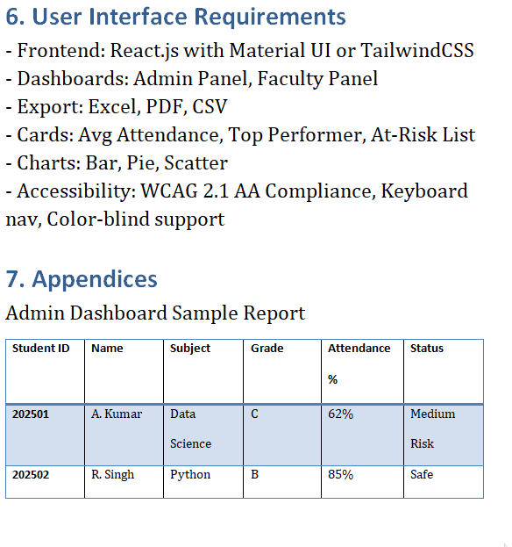

Slide 13
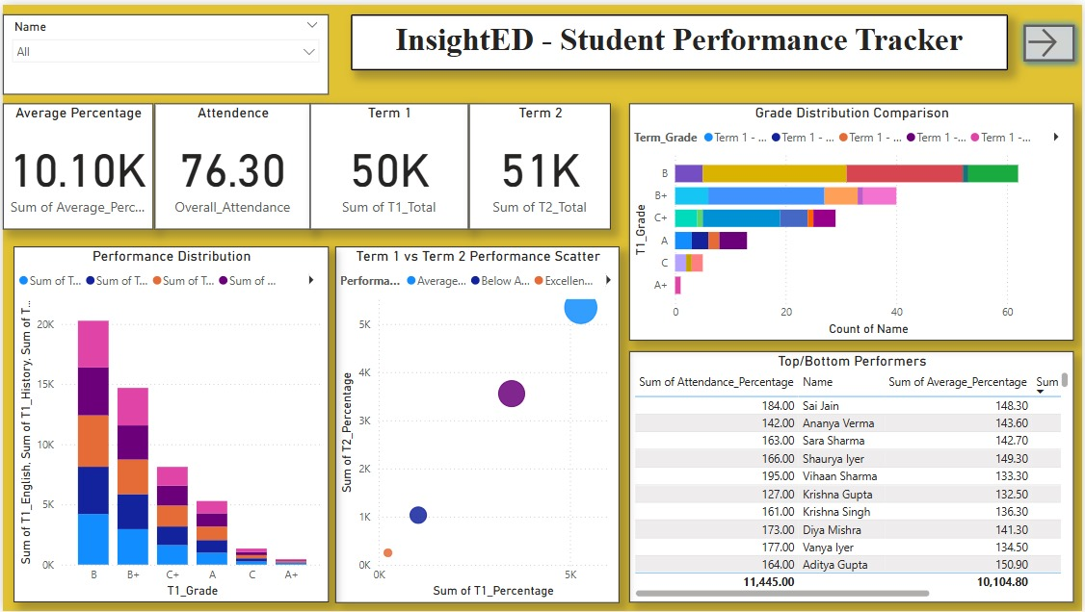
This Power BI dashboard, titled "InsightED – Student Performance Tracker", offers a comprehensive visual analysis of student metrics including average percentage, attendance, and grade distribution across terms. It enables quick insights into top/bottom performers and highlights performance trends using AI-powered data visualization.

Slide 14
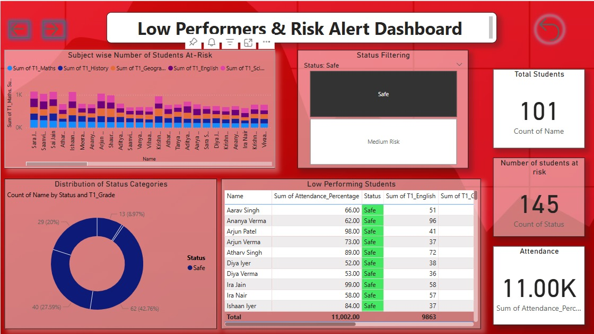
This Power BI dashboard titled "Low Performers & Risk Alert Dashboard" highlights at-risk students based on subject-wise performance and attendance. It provides a visual breakdown of student status (safe vs. medium risk) and enables early intervention through risk-based filtering and performance trends.

Slide 15
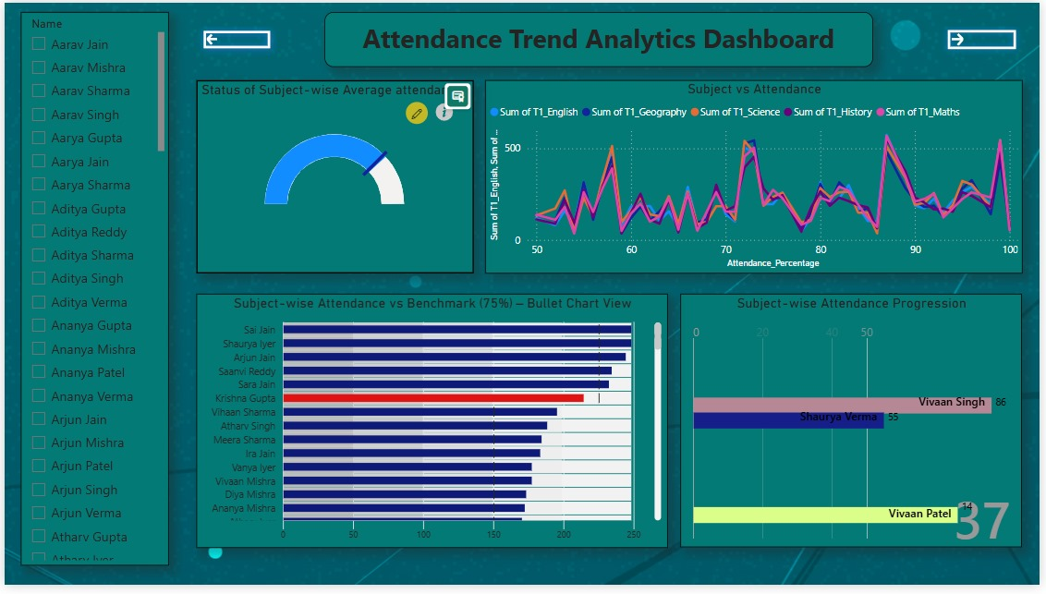
This Attendance Trend Analytics Dashboard visualizes student attendance patterns across subjects, highlighting those falling below the 75% benchmark. It combines line, bullet, and progression charts to track individual attendance trends and support timely academic interventions.

Slide 16
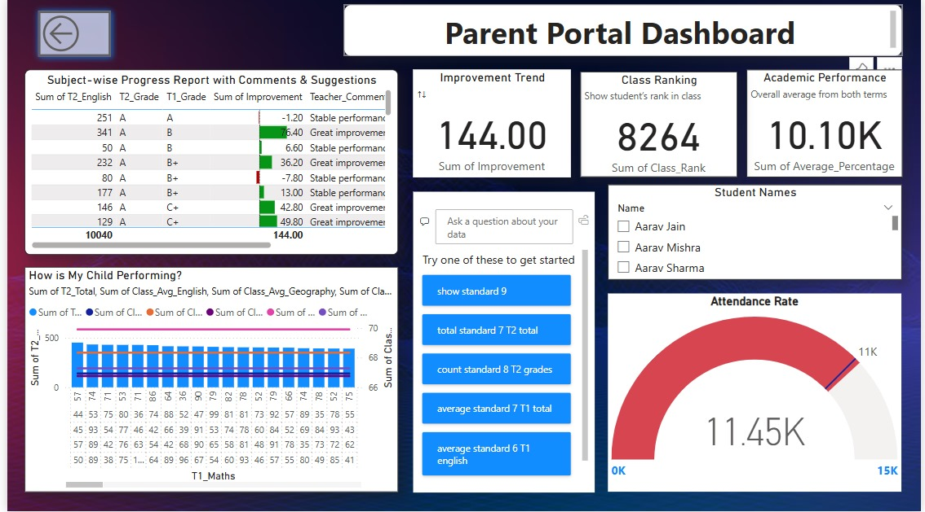
The Parent Portal Dashboard provides a personalized view of student progress, showcasing subject-wise improvements, teacher feedback, class ranking, and attendance. It empowers parents with clear insights into their child’s academic and behavioral trends for informed involvement.

